Slide 1


“Veera – Voice Assistant”
Dept. of CS&E ( DATA SCIENCE)
Adichunchanagiri Institute of Technology
Chikkamagaluru - 577102
Presented By,
Varshini Kakade S (4AI22CD060)
Vishruth CS (4AI22CD061)
Vaishnavi CV (4AI22CD059)
Raghav Nayak (4AI22CD041)
Under the Guidance of
Prof. Harshitha HD

Slide 2
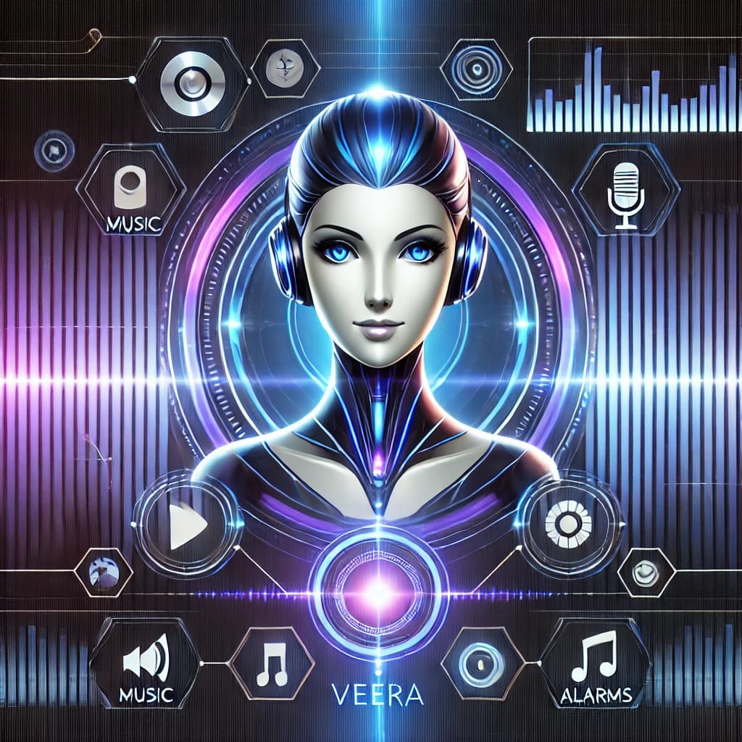
Veera - Voice Assistant

Slide 3
Problem Definition
“To design and implement a voice-activated virtual assistant for laptops, which is capable of understanding and responding to tasks in real-time.”
The voice assistant eliminates the need for keyboards and touchpads, making it ideal for users with disabilities or those who prefer a more convenient way to interact with their systems.

Slide 4
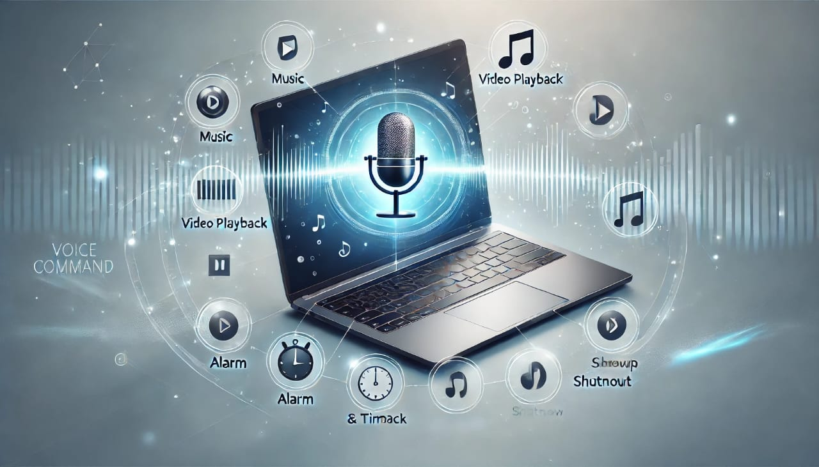
Scope of the Project
Key Area the Project Focuses On
Voice Command Automation.
User Accessibility
Core Functionalities:
Playing music/videos on YouTube.
Setting alarms and timers.
Shutting down the system.
Expected Impact or Benefits
Convenience: Reduces manual effort by automating everyday tasks.
Efficiency: Saves time by providing quick voice-activated responses.
Accessibility:Makes technology easier to use for individuals with physical limitations.

Slide 5
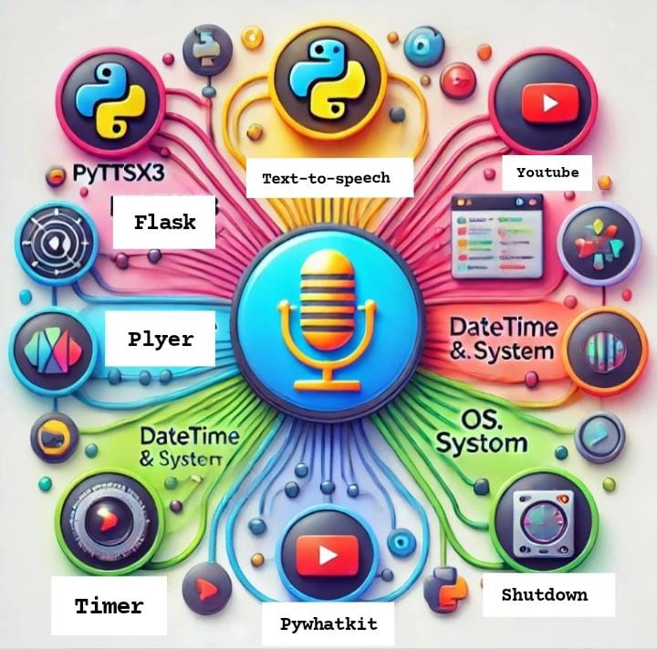
Project Design
Hardware: A computer with at least 4GB RAM and basic storage.
Software Components
Frontend:
HTML, CSS, JavaScript for user interaction
JavaScript constructs- webkitSpeechRecognition and
initializeWakeWordRecognition
Backend:
Flask framework for handling requests and processing commands.
Core Libraries:
pyttsx3: Text-to-speech conversion.
pywhatkit: Playing videos or songs on YouTube.
plyer: Sending desktop notifications.
re: Parsing and validating commands.
System APIs:
os.system: For shutting down the laptop.
Python threading: To handle timers, alarms, and shutdown without blocking.

Slide 6
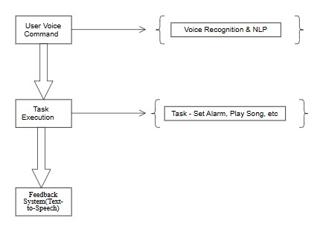
Block Diagram

Slide 7
Methodology
Steps or Approach Followed
Requirement Analysis:
Identified core functionalities: playing YouTube videos, setting alarms, timers, and shutting down the system.
Defined the scope for voice-based commands and backend integration.
Frontend Development:
Designed a simple and responsive interface using HTML, CSS, and JavaScript.
Integrated voice recognition using the webkitSpeechRecognition API.
Backend Development:
Built a Flask-based backend to process voice commands.
Core Functionality Implementation:
Integrated Python libraries for specific operations.
Testing and Debugging:
Ensured the assistant could recognize commands accurately.
Validated seamless communication between the front end and backend.

Slide 8
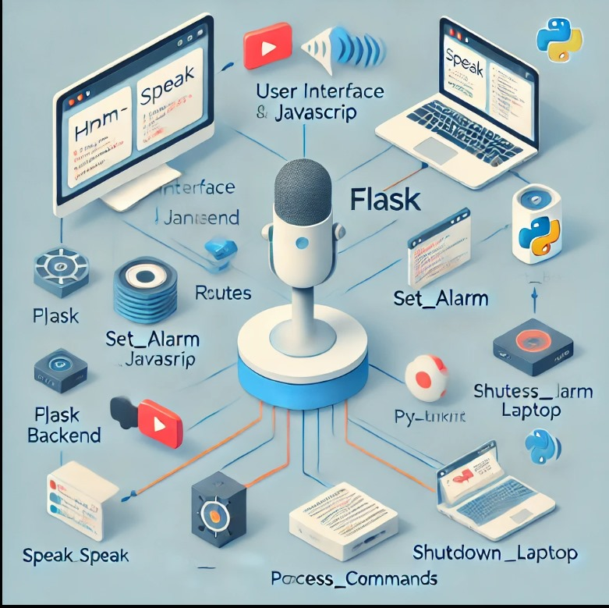
Tools and Technologies Used
Frontend Tools:
HTML/CSS: For creating a responsive and visually appealing interface.
JavaScript: For real-time voice recognition and interaction.
Backend Tools:
Flask Framework: For building and managing web application
Technologies and Libraries:
Voice Recognition: webkitSpeechRecognition for detecting wake words and commands.
Text-to-Speech: pyttsx3 for audio feedback.
YouTube Integration: pywhatkit for playing songs and videos.
Timers and Alarms: datetime, plyer, and winsound for time-based notifications.
Concurrency: Python threading for non-blocking operations.

Slide 9
Implementation
Pseudocode
# Import required libraries
Import Flask, JSON, threading, time, notification, re, datetime, etc.
# Route: Process Commands
Define `process_command()`:
Parse command from request
Handle commands like:
- "Play song/video": Play on YouTube
- "Set alarm": Start alarm thread
- "Set timer": Start timer thread
- "Shut down": Shutdown laptop
- "Exit": Respond with goodbye

Slide 10
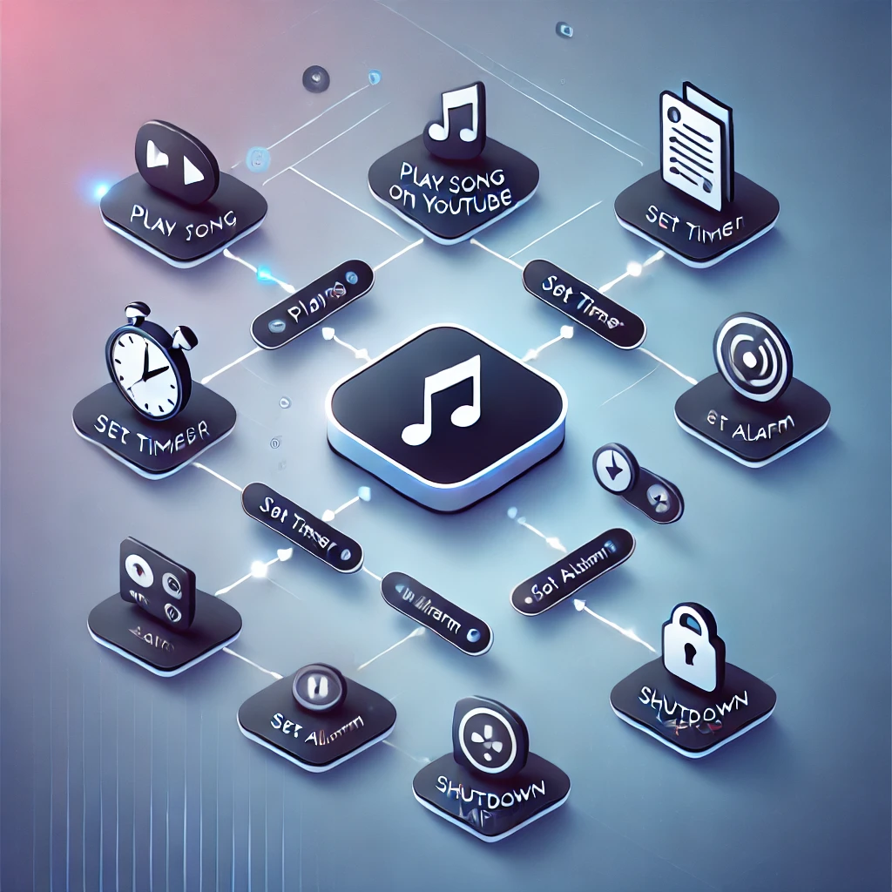
# Function: Set Alarm
Define `set_alarm(alarm_time)`:
Parse and validate time input
Calculate alarm datetime
Wait until alarm time
Trigger notification, play sound, and speak message
# Function: Set Timer with Countdown
Define `set_timer_with_countdown(seconds)`:
Display countdown using Tkinter
Wait for timer to end
Trigger notification, play sound, and speak message
# Function: Shutdown Laptop
Define `shutdown_laptop()`:
Speak shutdown message
Execute system shutdown command

Slide 11
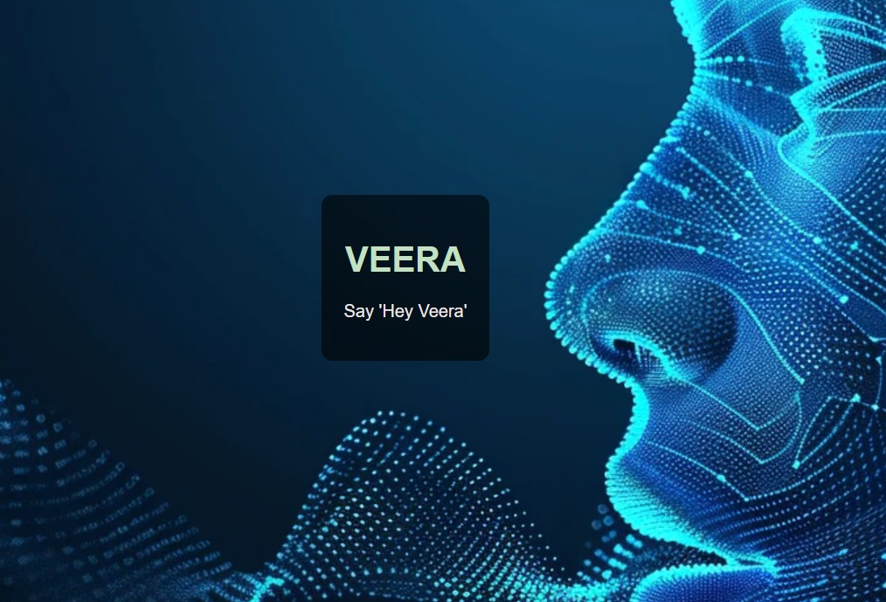
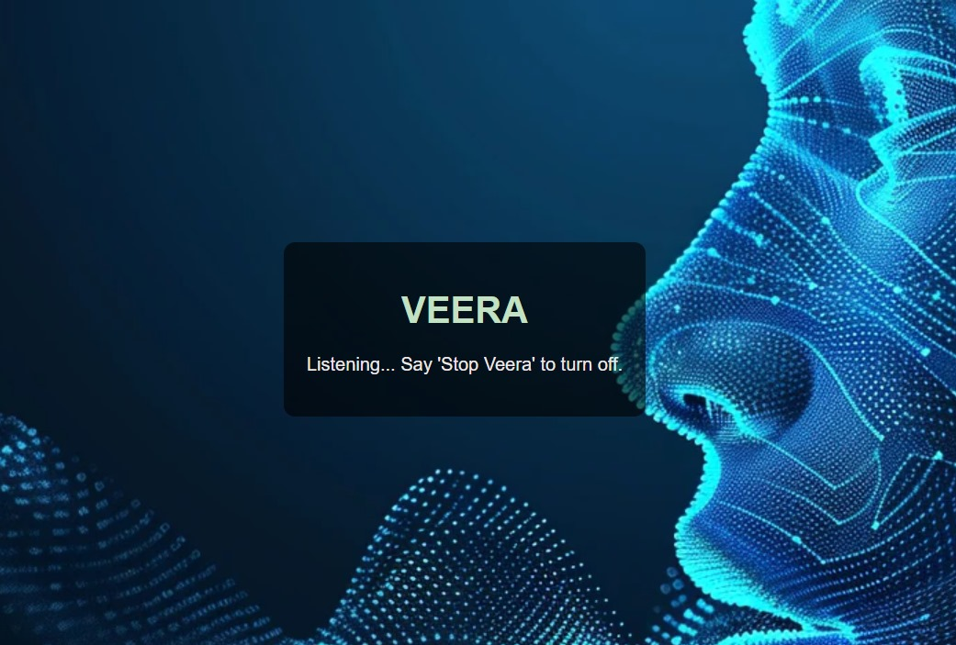
Result
1. Wake-Up Word Detection
User Command: "Hey Veera"
Response Message: “Listening…Say ‘Stop Veera’ to turn off”

Slide 12
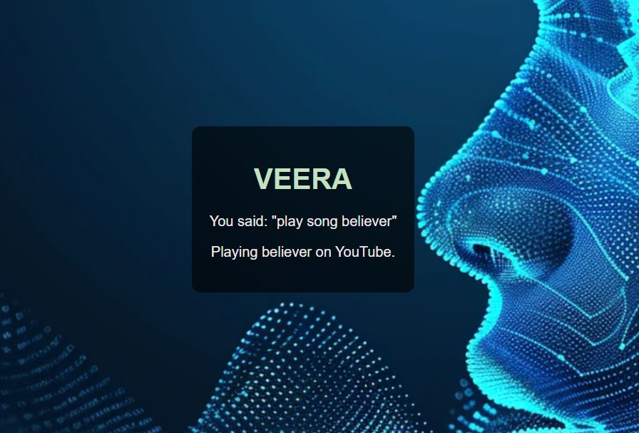
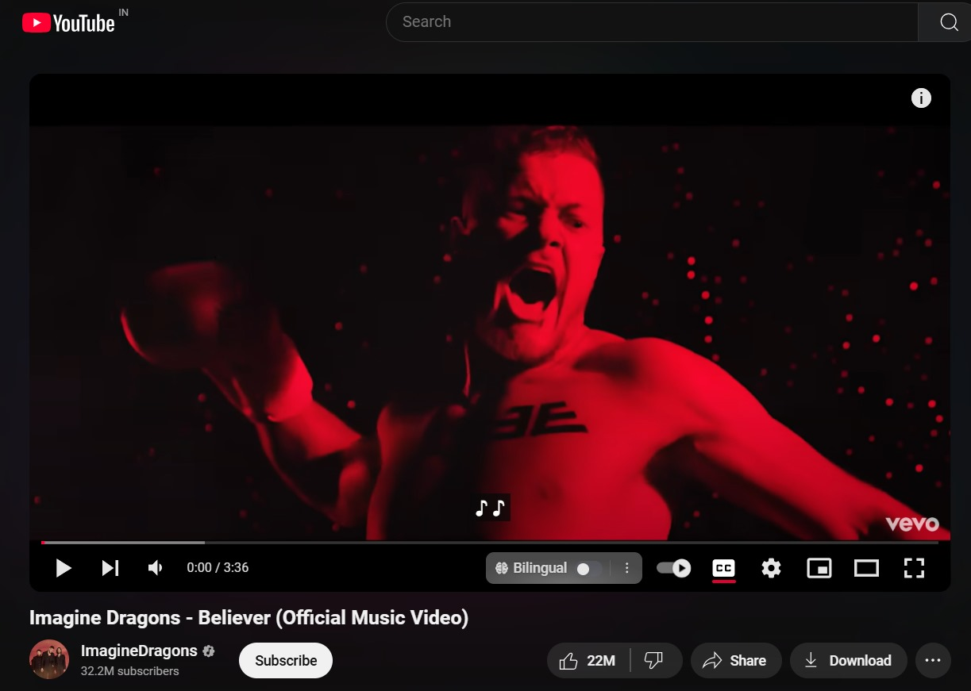
2. Play Music or Videos:
Redirects to YouTube to play the requested song or video using pywhatkit.
User Command: "Play song [song name]/ Play video [name]“
Response: “Playing [song] on Youtube”

Slide 13
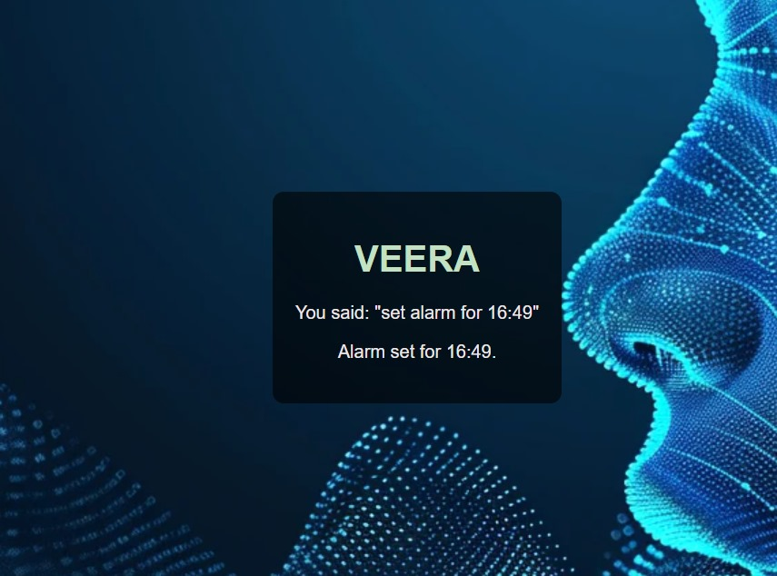
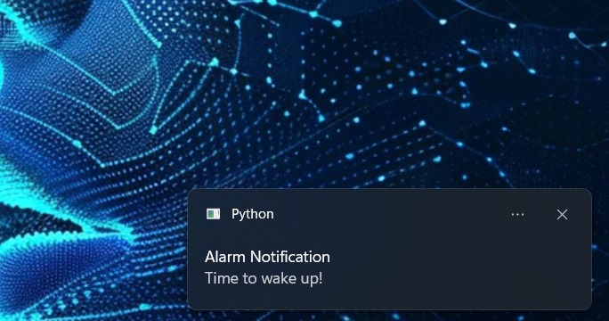
3. Set Alarms:
Users can specify a time in the HH: MM format to set an alarm.
User Command: “ Set alarm for 11:30."
Response: “ Alarm set for 11:30.”

Slide 14
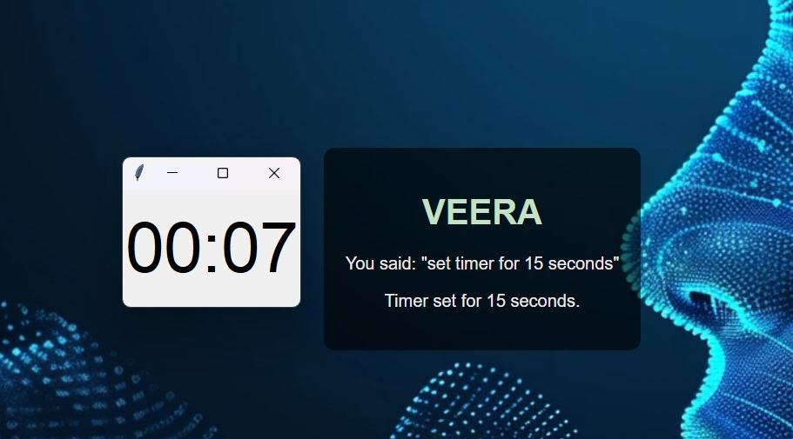
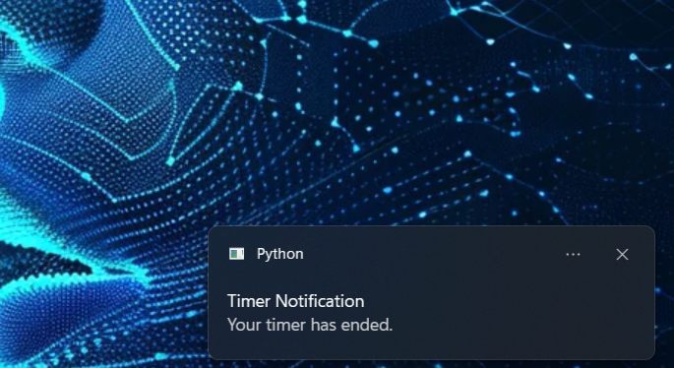
4. Set Timers:
Allows users to set a countdown timer for a specific duration in seconds.
User Command: “Set timer for 15 seconds."
Response: “Timer set for 15 seconds.”

Slide 15
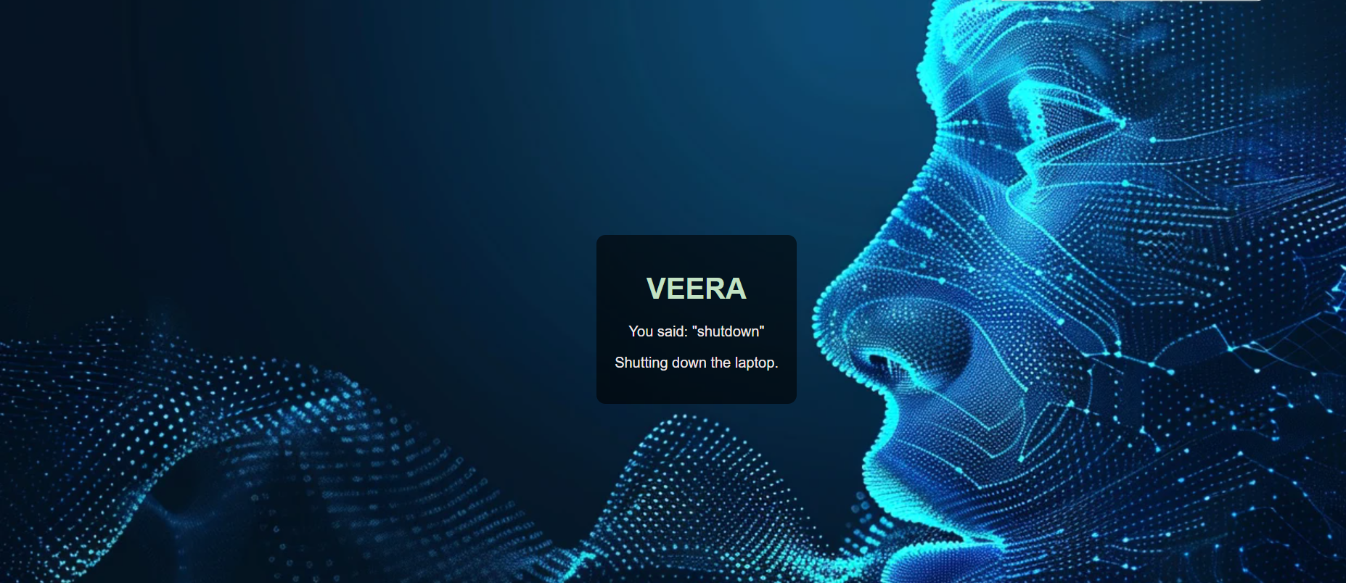
5. System Shutdown:
Executes a system command to shut down the laptop.
User Command: “Shut down.“
Response: “ Shutting down the laptop.”

Slide 16
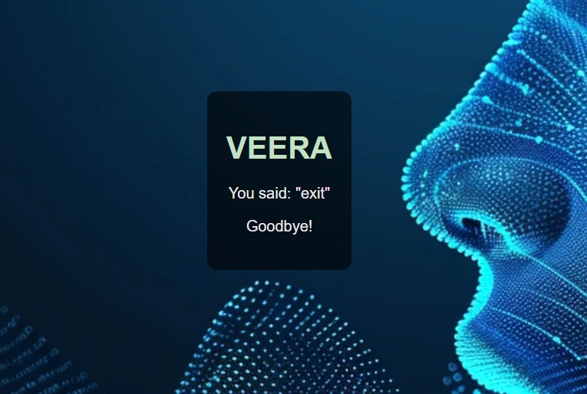
6. Stop Veera:
The command deactivates the assistant, stopping its listening and processing until reactivated with the wake word.
User Command: “Stop Veera / Exit”
Response: “ Bye! Until next time”

Slide 17
Challenges Faced
Frontend-Backend Integration:
Issue: Establishing smooth communication between the frontend and backend was challenging.
Resolution: Ensure smooth Flask frontend-backend integration by using JSON responses
2. Alarm and Timer Notifications:
Issue: Notifications for alarms and timers were not consistently triggering or syncing with the system time.
Resolution: Refined the logic using datetime for precise timing and tested various scenarios to ensure reliability.
Voice Recognition Accuracy:
Issue: Misinterpretation of commands due to accents or background noise.
Resolution: Adjusted the webkitSpeechRecognition settings and added error handling for repeated attempts.
Wake-Up Word Detection:
Issue: Continuous listening for the wake word ("Hey Veera") sometimes caused delays or interruptions.
Resolution: Optimized the recognition loop with separate threads for wake-word detection and command processing.
Timer Countdown UI:
Issue: Implementing a real-time graphical countdown timer using tkinter without freezing other tasks was tricky.
Resolution: Used multi-threading to run the timer independently while maintaining GUI updates.

Slide 18
Future Work
To further increase the effectiveness and versatility of the Veera Voice Assistant, the following enhancements are proposed:
Adding More Operations:
Expand the range of functionalities, such as launching applications, managing files, controlling system settings, or sending emails, to make the assistant even more effective for users.
Integration with IoT Devices:
Extend support to IoT-enabled devices, such as smart lights, thermostats, or home automation systems, allowing users to control their smart home environment directly through the assistant.

Slide 19

Conclusion
The Veera Voice Assistant successfully fulfills its objective of simplifying and automating laptop functions through voice commands. By enabling users to play music via YouTube, set alarms, configure timers, and shut down the system seamlessly, it delivers an efficient and user-friendly experience tailored to laptop users.
This project demonstrates the advantages of voice-assisted technology by enhancing user interaction, minimizing manual efforts, and streamlining system operations.
Veera Voice Assistant has the potential to redefine how users interact with their devices, showcasing the power of voice commands in everyday computing tasks.

Slide 20
GitHub Link
Vasrhini Kakade S : https://github.com/Varshini-kakade
Vaishnavi C V : https://github.com/cvvaishnavi
Vishruth C S : https://github.com/VishruthCS
Raghav Nayak : https://github.com/abcd-raghav

Slide 21
Thank You

